Slide 1
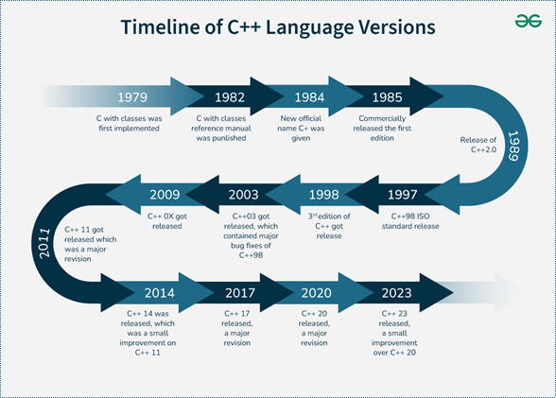
C++ Versions

Slide 2
C++ 11 Features
  lambda Expression
  auto keyword
  nullptr
  Range Based For Loop
  uniform Initialization list
  non-static data members initializers
  new data types
  final / override
  decltype
  delete
  Strongly typed enums – scoped enums
  move Semantics – move constructor and assignment
  constructor delegation
  user defined literals
  rvalue reference
  Forwarding references
  Static assertions
  type alias
  attributes
  constexpr and literal types
  converting constructors
  explicit conversion functions
  Inline namespace
  Right angle brackets
  ref qualified member functions
  trailing return types
  noexcept specifier
  char32_t and char16_t
  raw string literals
  alignof and alignas
  Thread-local storage
  defaulted and deleted functions
  delegateting and inherited constructors
  variadic templates

Slide 3
C++ 11 Libraries
  <array>
  <atomic>
  <cfenv>
  <chrono>
  <cintypes>
  <conditional_variable>
  <cstdint>
  <cuchar>
  <forward_list>
  <future>
  <initializer_list>
  <mutex>
  <random>
  <ratio>
  <regex>
  <scoped_allocator>
  <system_error>
  <thread>
  <tuple>
  <typeindex>
  <type_traits>
  <unordered_map>
  <unordered_set>

Slide 4
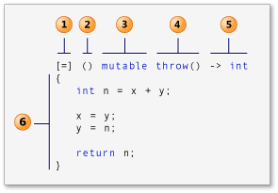
Feature: Lambda Expression
Lambda expressions, also known as closures, lambda functions, function literals, or just lambdas, have their own unique syntax
lambdas are used to encapsulate a few lines of code that are passed to Algorithms or Asynchronous functions
The below are the list of compilers which supports Lambda expressions:
GCC 4.5 – Specify –std = c++11
Microsoft Visual Studio 2010
The basic syntax of lambda expression is:
Conciseness and Readability
Lambdas allow us to define small, self-contained functions inline, this can improve code readability by keeping logic together
Anonymous Functions
Lambda are anonymous i.e. they don’t need function name which makes them ideal for function needed for a specific context
Functional Programming
Lambda allow to pass function to other function as argument it enables higher order functions and more flexible code structures
Capturing State
Lambda provides capability to capture by value and reference which allows them to access and modify external data within their own scope
Efficient
Lambdas are efficient because they compiled directly into the code without the overhead of creating and managing separate objects
Inline Function Definition
Lambdas can be defined directly where they are used, reducing clutter and making the code easier to follow

Slide 5
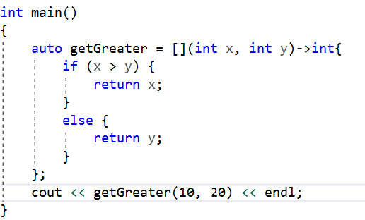
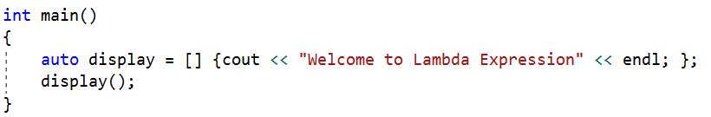
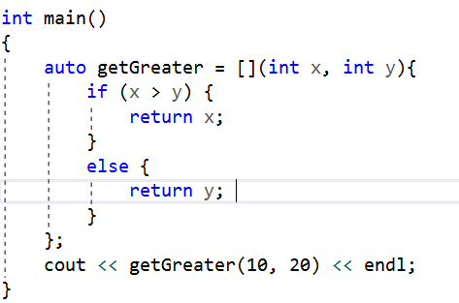
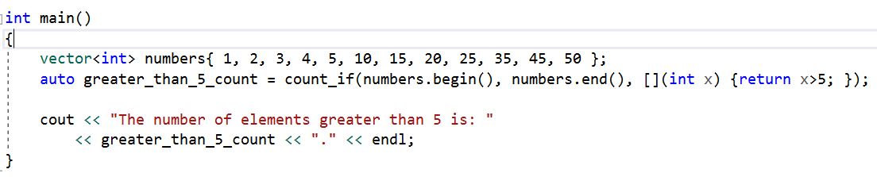
Use case descriptions
Lambda Expression continued…
Case 3 – The return type can be mentioned in lambda expression
Case 1 – The lambda function which doesn’t take any argument
Case 2 -- The lambda expression which takes argument
Cpp11/lambda_example2.cpp at main · shidlingayya/Cpp11
Case 4 – This lambda expression very helpful with STL algorithms such as count_if
Cpp11/lambda_example3.cpp at main · shidlingayya/Cpp11
Cpp11/lambda_exampl1.cpp at main · shidlingayya/Cpp11

Slide 6
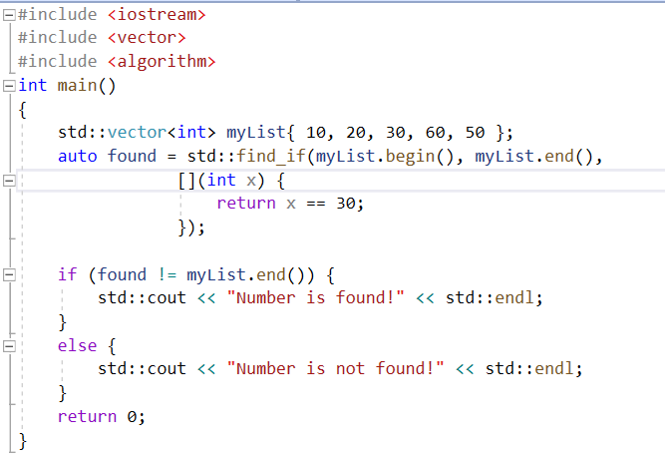
Lambda Expression continued…
  The capture clause is used to (indirectly) give a lambda access to variables available in the surrounding scope that it normally would not have access to
  How lambda function works?
    When lambda function is executed, for each variable that lambda captures, a clone of that variable is created with identical name inside lambda. These cloned variables are initialized from the outer scope variables same name at this point
    The captured values are treated as a const – Meaning we can’t modify these captures inside lambda definition unless it is defined as a mutable
The captures can be of following types
  Capture by Reference - [&] : capture all external variables by reference
  Capture by Value - [=] : capture all external variables by value
  Capture by mixed - [a, &b] : capture a by value and b by reference
In this example always 30 being checked, If want to pass the custom input value to check different values for program. Then there has to be some means to pass value to Lambda definition, this can be achieved with capture

Slide 7
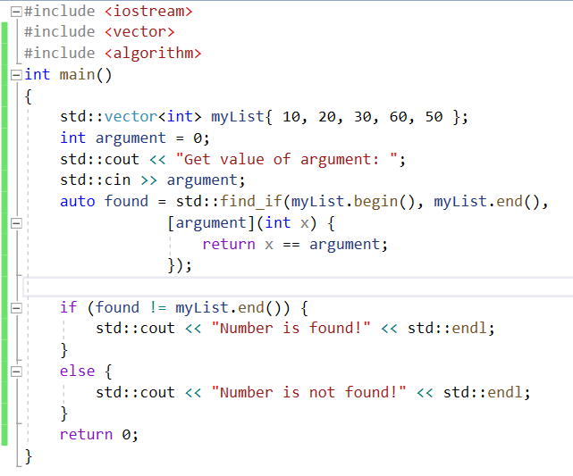
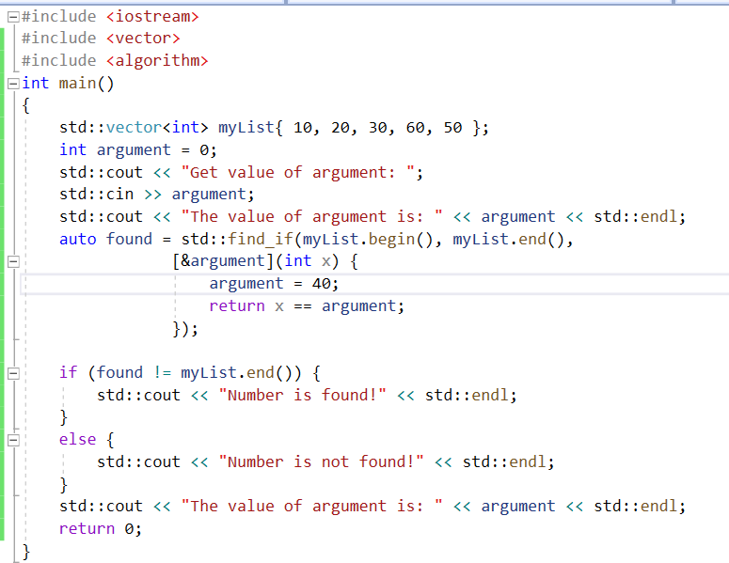
Lambda Expression continued…
Case 1: Capture by Value (non-modifiable)
  Case 2: Capture by reference: This type of capture by default modifiable..

Slide 8
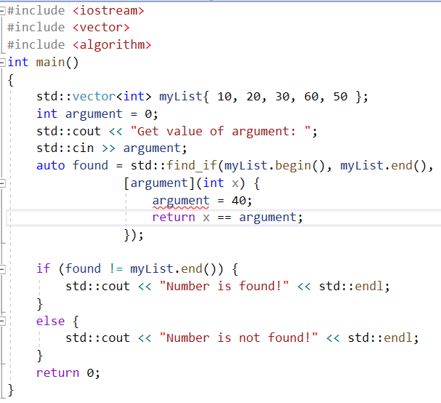
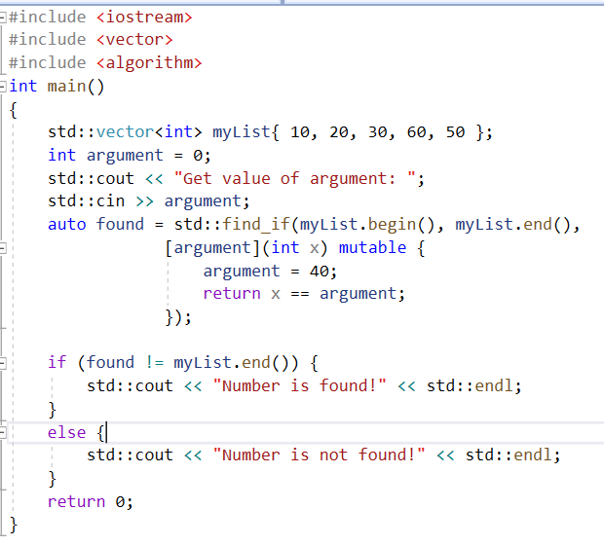
Lambda Expression continued…
The captured value is constant in nature & can’t be modified
Cpp11/capture_by_value_const_in_nature.cpp at main · shidlingayya/Cpp11
Cpp11/capture_by_value_mutable.cpp at main · shidlingayya/Cpp11

Slide 9
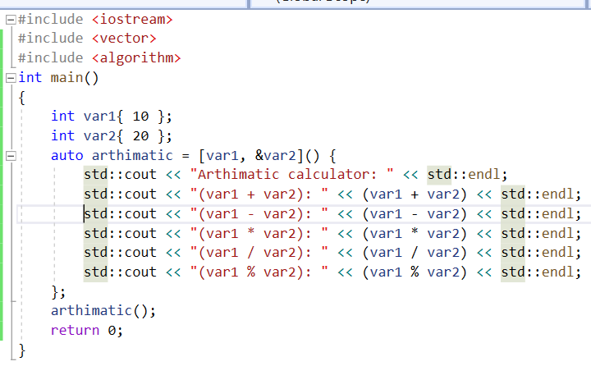
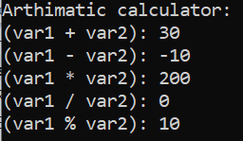
Lambda Expression continued…
  Case 3: Capture by mixture: We can mix both capture by value and capture by reference
var1 captured using value
var2 capture using reference
Cpp11/capture_by_value & capture by reference.cpp at main · shidlingayya/Cpp11

Slide 10
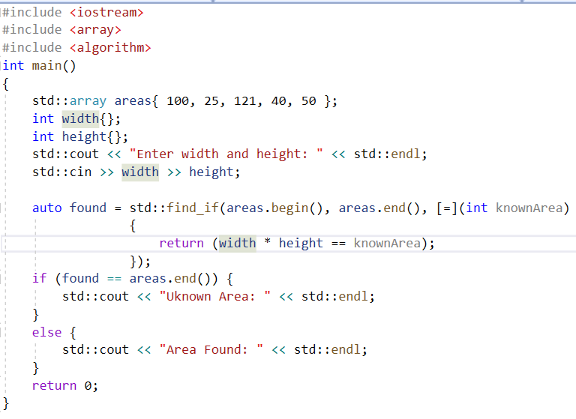
Lambda Expression continued…
  Default capture:
  A default capture (also called a capture-default) captures all variables that are mentioned in the lambda.
  Variables not mentioned in the lambda are not captured if a default capture is used
  The default capture has to be first argument always in capture list if more than one argument is being passed
width and height are captured because they are mentioned..
Cpp11/capture_by_default.cpp at main · shidlingayya/Cpp11

Slide 11
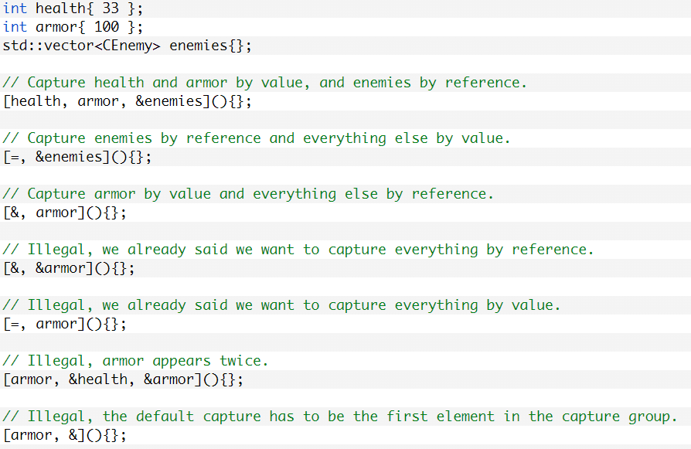
Lambda Expression continued…
  Default capture can be mixed with normal captures, we can capture some variables by value and some values by reference. But each value must be capture only once

Slide 12
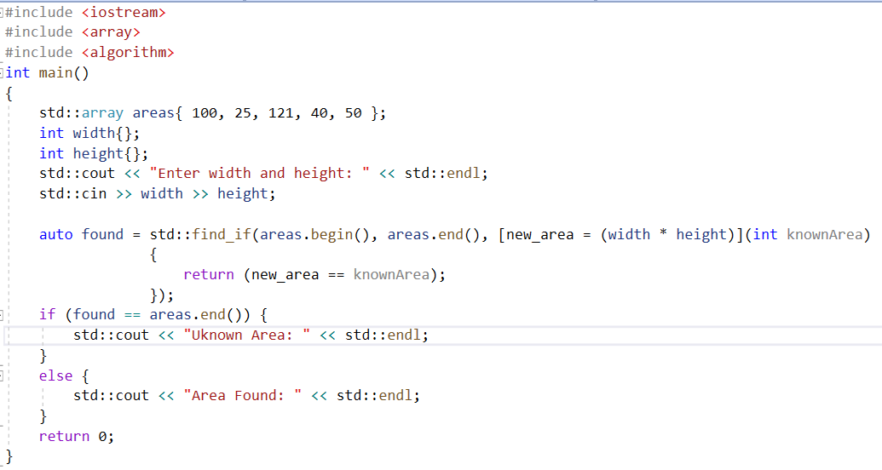
Lambda Expression continued…
  There can be new value declared in lambda definition – No need to specify type of lambda variable which is declared inside lambda definition
new_area is new variable only applicable to lambda definition scope

Slide 13
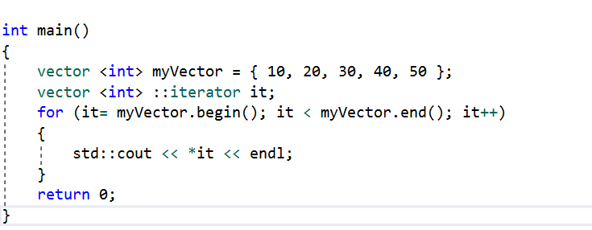
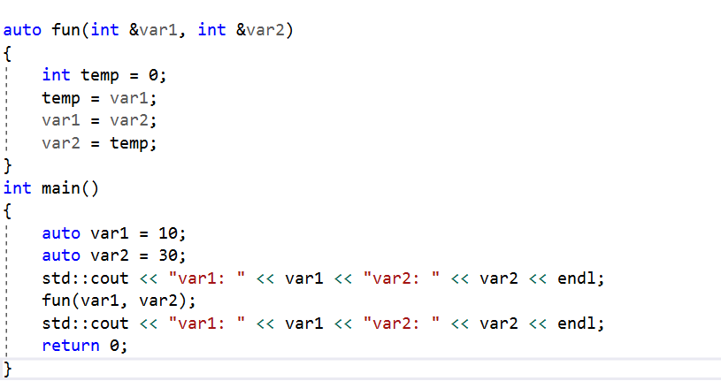
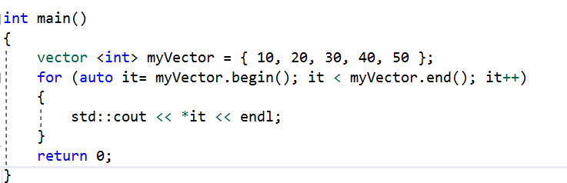
Feature: auto
Earlier version of auto keyword got deprecated (was storage class)
The “auto” keyword can be used to implicitly identify the type of variable during compile time
  Variable declaration
  Function return type
Without “auto”
With “auto”
Cpp11/auto_feature.cpp at main · shidlingayya/Cpp11

Slide 14
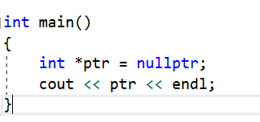
Feature: nullptr
nullptr is a keyword that represents zero as an address
If we are writing something where we're referring to the zero address, rather than the value zero, we should use nullptr
The NULL used to initialize the pointer – Its value is 0 -- hence 0 is double role for initializing integer & pointers – Is not good idea
In C++11 – nullptr is introduced to initialize the pointer
void f(int);
void f(int*);
f(NULL); // calls f(int) — surprising!
f(0); // also calls f(int)
f(nullptr); // calls f(int*) — clear and correct

Slide 15
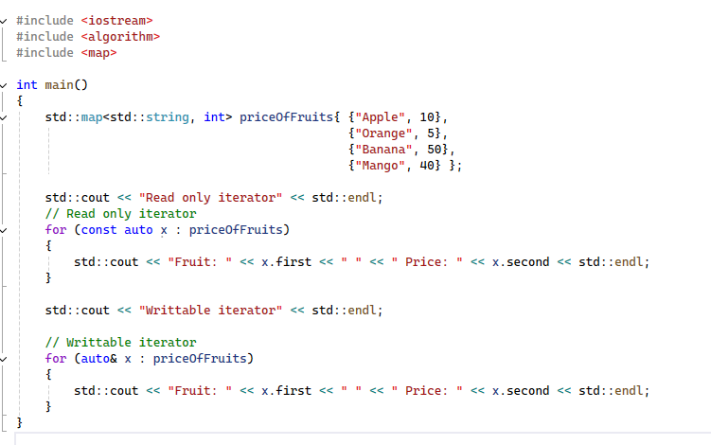
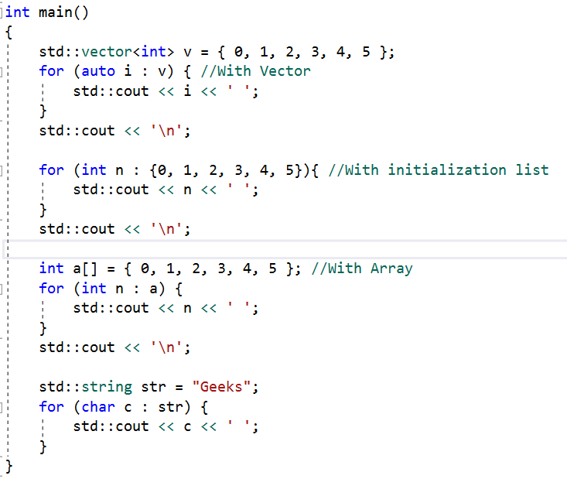
Feature: Range Based For Loop
The generic format of Range Based for loop as follows:
  for(range_declaration: range expression) {
  loop statement;
  }
Helpful in accessing map made easy:
Cpp11/range_based_for_loop.cpp at main · shidlingayya/Cpp11

Slide 16
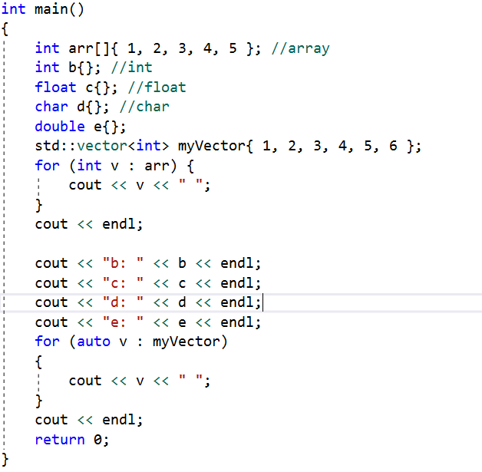
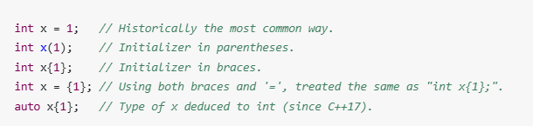

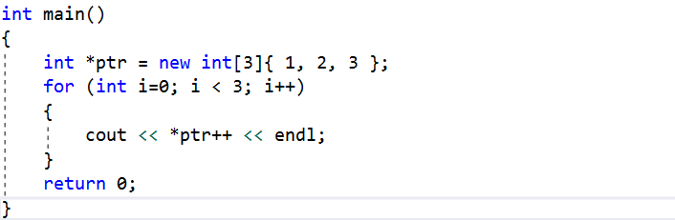
Feature: Uniform Initialization List
Uniform initialization, since C++11 (a.k.a. modern C++ era), is the practice of using “brace initialization” {} to initialize a variable or an object
There are multiple ways to initialize the object as follows:
The uniform initialization list won’t work directly with implicit conversion expected
With explicit typecasting this can be made work as follows:
The C++ 11 allows to initialize array, vector etc. same as constructor in C++
Before c++11, It is not possible to allocate & initialize array at single instant time
!!!ERROR
Cpp11/uniform_initialization.cpp at main · shidlingayya/Cpp11

Slide 17
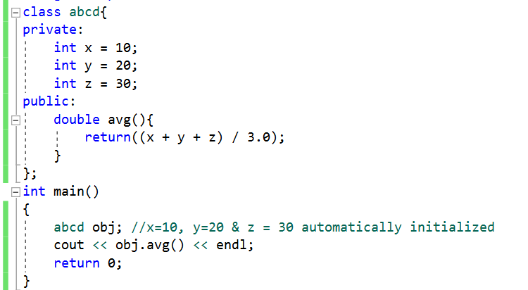
  Feature: Non-Static data members initializers
Before c++11, We can’t assign values directly inside the class – we can assign non-static values directly inside class
This will avoid default constructor functionality by allowing to initialize during declaration
The constructor can override these values
We can’t use () for initialization
Directly non-static data members can be initialized
Cpp11/in_class_initialization.cpp at main · shidlingayya/Cpp11

Slide 18
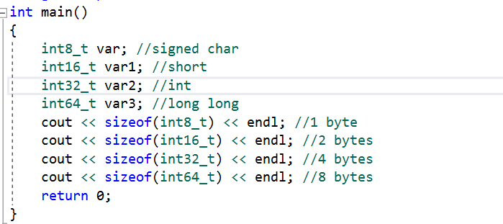
Feature: New Data Types
Before c++11, even if integer needs only one byte of memory.. We used 4 bytes of memory
In C++11, new data types introduced to handle integer of 1, 2, 4 bytes etc.

Slide 19
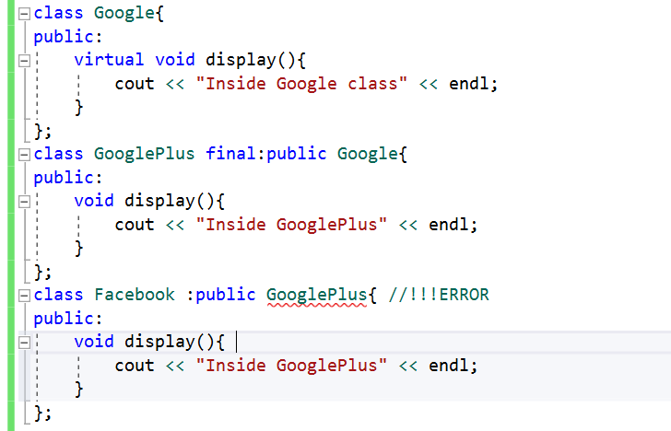
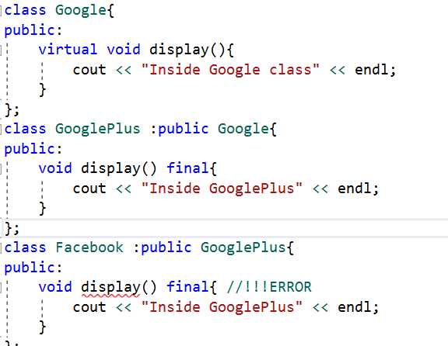
Feature: final Keyword
The keyword final can be applied to virtual functions & Inheritance
The keyword final can be used to limit number of times derived class overriding virtual functions derived classes
The keyword final can be applied inheritance to avoid further inheritance for classes
Cpp11/final_keyword_inheritance.cpp at main · shidlingayya/Cpp11
Cpp11/final_keyword_virtual_function.cpp at main · shidlingayya/Cpp11

Slide 20
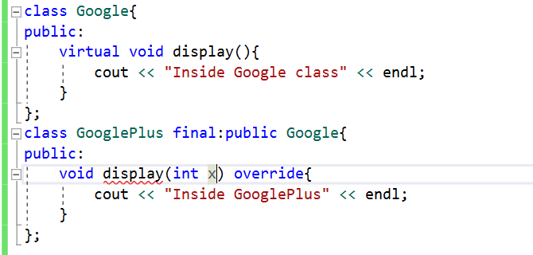
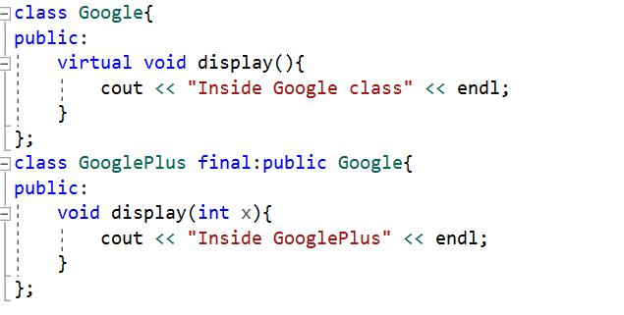
override
The override keyword in C++11 is used to indicate that a member function is meant to override a virtual function from a base class.
It enables the compiler to check and verify that the overriding actually happens.
With Override keyword
Catching signature mistakes
Cpp11/override_keyword_caught_signature_mismatch.cpp at main · shidlingayya/Cpp11
Cpp11/override_signature_mismatch.cpp at main · shidlingayya/Cpp11

Slide 21
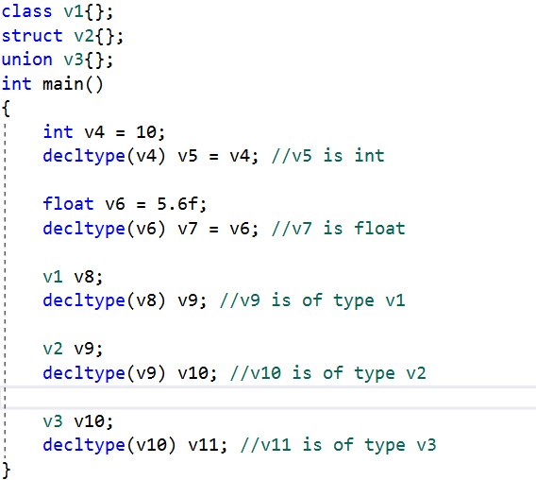
Feature: decltype
Copy the declaration type of variable without specifying actual data type with variables

Slide 22
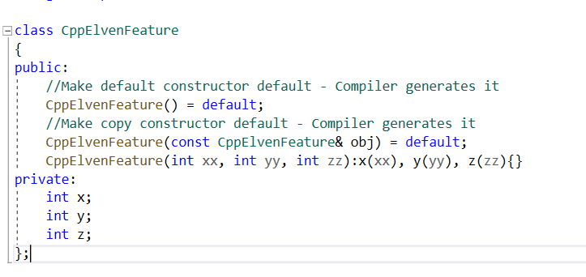
Feature: default Keyword
default keyword used to make special member functions to generate from compiler
If we add default keyword it makes code trivial it means continuous memory allocated for special member function
Only special member functions can be made as a default
The special member functions which takes “default arguments” can be made as a default
Making special member function as a “default” makes class/struct as a “trivial” means continuous memory allocated for class/struct
Another good use case of using default is when our class is having parameterized constructor. Explicitly defining parameterized constructors causes compiler to not generate the default constructor – default feature solve this issue

Slide 23
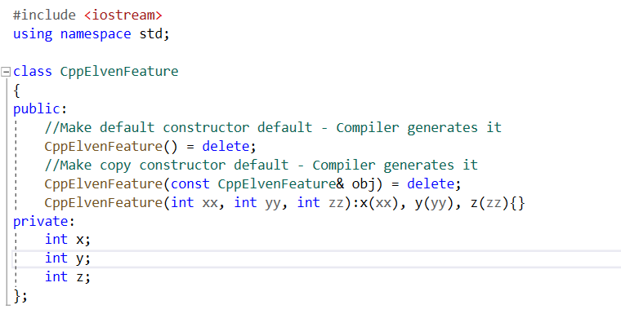
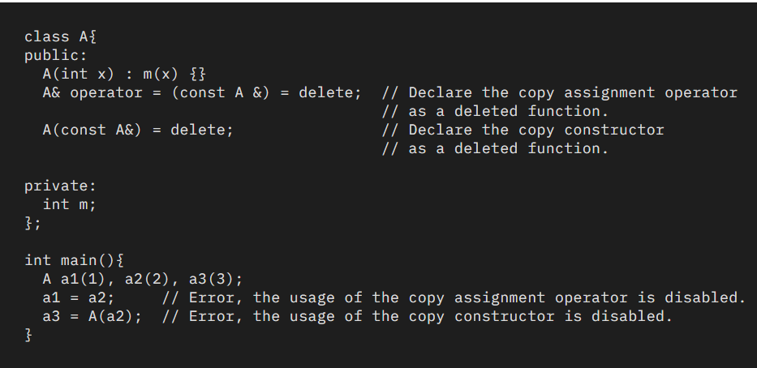
Feature: delete Keyword
delete keyword used to disable compiler generates special member functions
  Default constructor, Default copy constructor, Default overloaded assignment operator
  Default Destructor
The compiler disables the usage of a deleted function
Cpp11/delete_feature.cpp at main · shidlingayya/Cpp11
The delete keyword can be only inline function
The delete can be used for normal function as well to avoid undesirable conversions

Slide 24
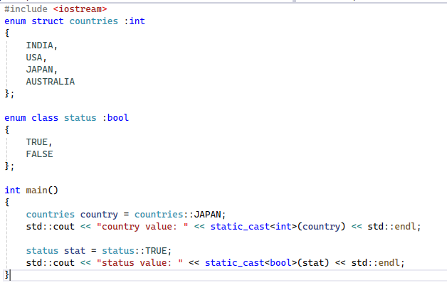
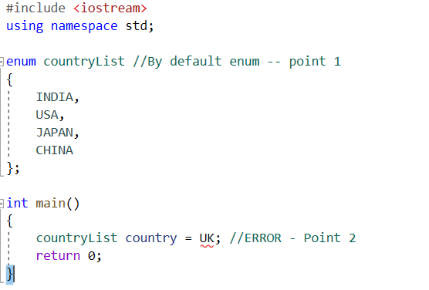
Feature: Strongly typed Enums
The drawbacks of enumerations in classical C++
  The enum values converted to int by default
  They introduce the enumerators in the enclosing scope (Only listed values can be used for enum operations)The type of enum can’t be specified
With strongly typed enums – all listed drawbacks can be overcome
  They can’t introduce enclosing scope to enum
  Must be accessed along with countryList which avoid name collusion
  Not converted to int by default & type can be specified while declaring type
  The syntax for strongly typed enums changed with extra ‘class/struct’ needs to be added
  enum colours → enum class/struct colours
  The type of enum can be specified in enum list, by default it will be int if not specified
  Need to use scope resolution operator while accessing enum members
Cpp11/strongly_typed_enum.cpp at main · shidlingayya/Cpp11

Slide 25
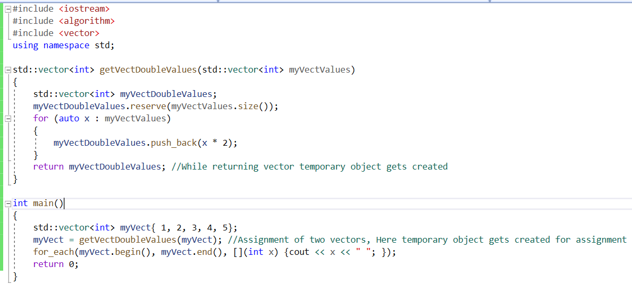
Move Semantics
In C++99 standard, if we attempt to copy the object while assigning then temporary object gets created
Moving an object means to transfer ownership of some resource it manages to another object
The first benefit of move semantics is performance optimization
When an object is about to reach the end of its lifetime, either because it's a temporary or by explicitly calling std::move, a move is often a cheaper way to transfer resources
In High performance, system this temporary object creation may leads to performance issues
Sometimes these temporary objects can be optimized away by the compiler (the return value optimization, for example). But this is not always the case, and it can result in expensive object copies
Duplicate copy of vector being created which is unnecessary

Slide 26
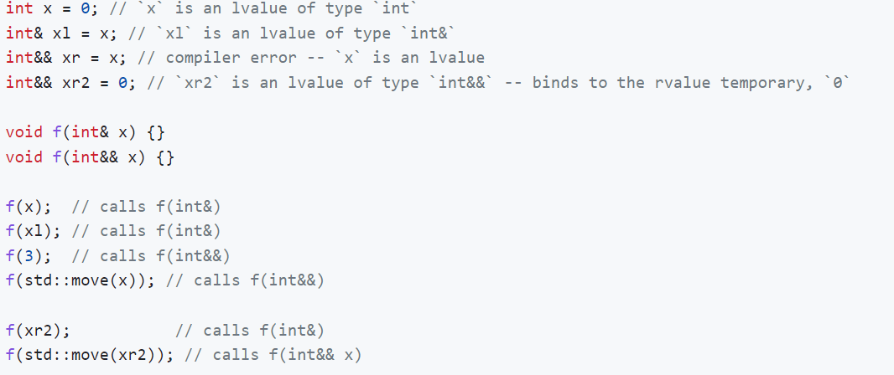
Move Semantics continued---> rValue References
C++11 introduces a new reference termed the rvalue reference
A rvalue reference to T, which is a non-template type parameter (such as int, or a user-defined type), is created with the syntax T&&
Rvalue references only bind to rvalues

Slide 27
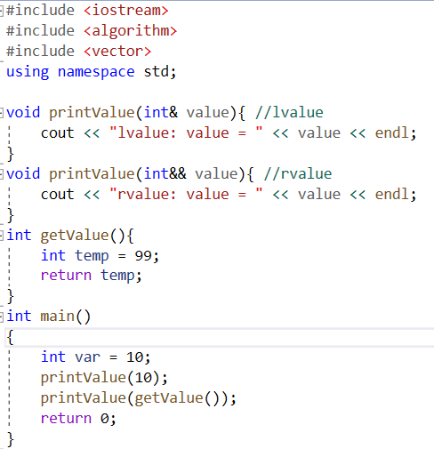
rvalue reference continued …:
  The expression said to be rvalue if it won’t result into “temporary object” creation
  int &&a;: new (C++11) declaration rvalue reference.
  non-const lvalue reference binds to an object.
  rvalue reference binds to a temporary object which typically will not be used again
  The rvalue reference can be used to create move constructor and move assignment operator
  The copy constructor works with l-value references and copy semantics – It means while creating object it will create temporary object rather than pointing to existing object
  The move copy constructor works with r-value references it means pointing to already existing objects
  Temporary Objects – They don’t have storage duration, they have life time duration specific to object.

Slide 28
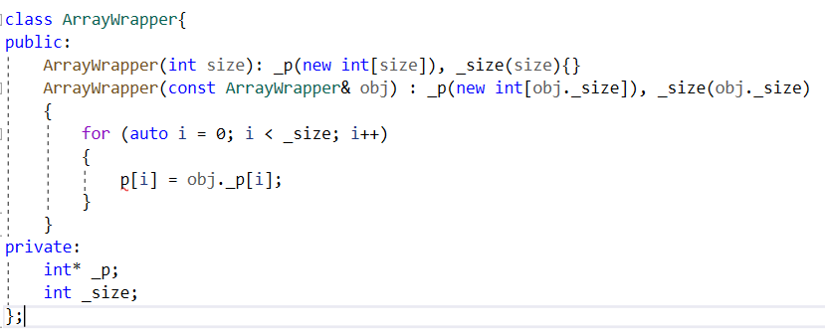
Move Semantics continued …
Move semantics is about transferring resources rather than copying them when nobody needs the source value anymore
Move semantics allows us to avoid unnecessary copies of objects when working with temporary objects
The resource needed for temporary objects can be used for other objects
It means we can just move the contents rather than copy the contents of a rvalue parameter
This saves lot of memory allocation and provides optimization for large dynamic structures
Move semantics is basically a user-defined type with constructor that takes r-value reference which is non-const input
Move semantics mostly used for implementing Move constructor and Move assignment operator
Here copying and memory allocation required in copy constructor

Slide 29
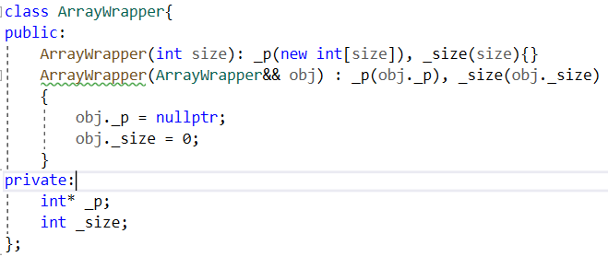
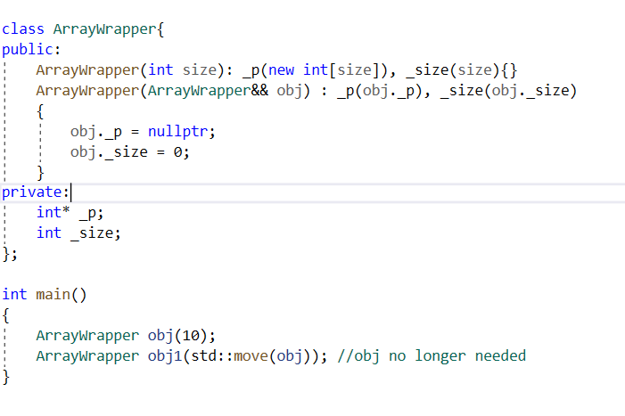
Move Semantics continued …
Cpp11/move_constructor.cpp at main · shidlingayya/Cpp11
Two main things – The object being passed is non-const and source object is set to nullptr
Setting pointer to nullptr important – If we don’t set to nullptr then when temporary object goes out of scope destructor again will invoke and try to free the memory – Which may introduce crash in the code
If the move constructor needs to take l-value object as input, then ::move call needs to be used
Std::move – is a cast which produces r-value reference to an object, to enable moving from it
::move cast obj from l-value reference to r-value reference
Obj is no longer needed in this case and it is copied to obj1.. Only obj1 is available for use

Slide 30
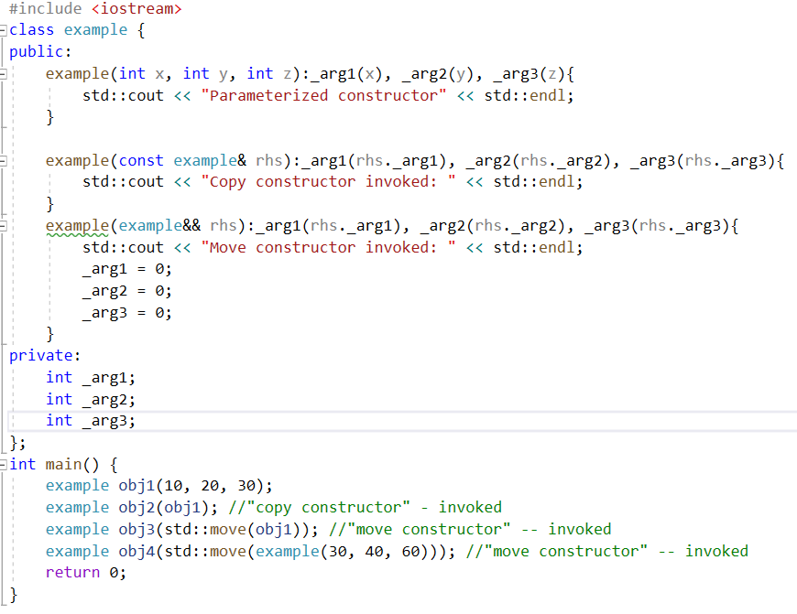
Move Semantics continued …
Parameterized constructor
Copy constructor invoked:
Move constructor invoked:
Parameterized constructor
Move constructor invoked:

Slide 31
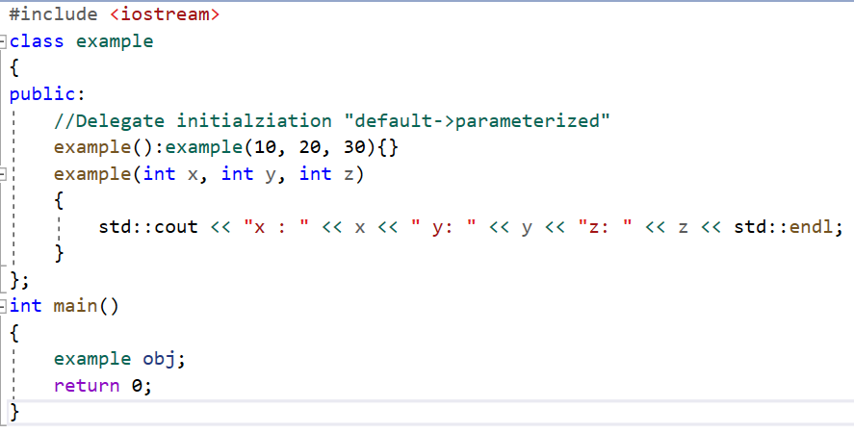
Feature: Delegating Constructor
In C++11, The constructor can delegate initialization
Default constructor invoking Parameter constructor. It is delegation of initialization from default constructor to parameter constructor

Slide 32
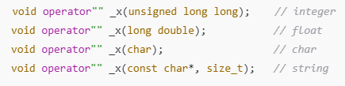
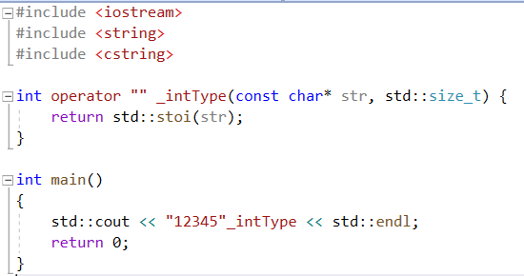
Feature: User defined Literals
There can be of below types:
  Integer literals
  Floating-point literals
  Character literals
  String literals
  Raw string literals
In C++11, The user can define user defined literal
The general syntax is as follows:
T operator "" X(...) { ... }
function that returns a type T, with a name X
Note that the name of this function defines the name of the literal
Any literal names not starting with an underscore are reserved and won't be invoked
The UDL concept mainly used in conversions or specifying units in coding
  Advantages
    The code becomes readable
    Conversion computations are done at compile time

Slide 33
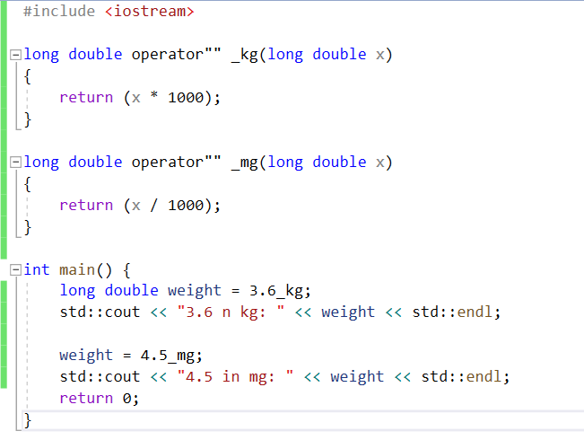
User Defined Literals continued …
We can define user-defined literals for user-defined types and the new form of literals for built-in types
The value of UDLs is substituted with the actual value defined in the code by the compiler at compile time
UDLs don’t save much coding time, but more calculations can be shifted to compile-time for faster execution
UDLs are treated as a call to a literal operator - Only suffix form is supported
The name of the literal operator is operator ” “ followed by the suffix
UDLs can only work with below types
char const*
unsigned long long
long double
char const*, std::size_t
wchar_t const*, std::size_t
char16_t const*, std::size_t
char32_t const*, std::size_t
The UDLs will be invoked here

Slide 34
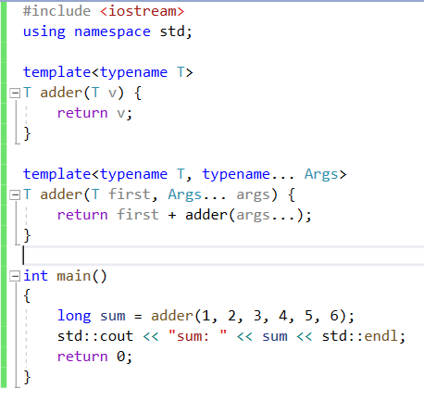
Variadic Function Template
Variadic templates are class or function templates, that can take any number of variable(zero or more)
In C++, templates can have a fixed number of parameters only that have to be specified at the time of declaration
Variadic templates help to overcome this issue
template(typename arg, typename... args)
return_type function_name(arg var1, args... var2)

Slide 35
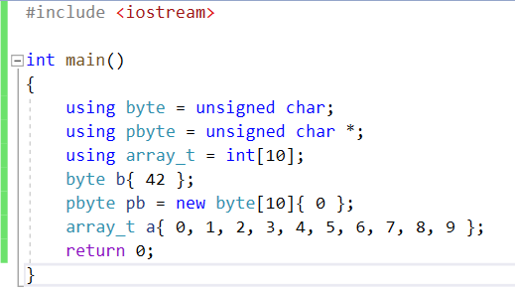
type alias
In C++, It is possible to create synonyms that can be used instead of type name – This can be achieved by using typedef declaration
typedef can be used in several use cases – Declaration simplification, providing meaningful names etc.
However, typedef can’t be used with templates
In C++11, a type alias is a name for another already declared type, and an alias template is a name for another already declared template
Create type aliases with the form using identifier = type-id

Slide 36
attributes
Attributes allow the programmer to specify additional information to the compiler to enforce constraints, optimize certain pieces of code or do some specific code generation
An attribute acts as an annotation or a note to the compiler which provides additional information about the code for optimization purposes and enforcing certain conditions on it
[[noreturn]] | This attribute used to indicate function should not return anything. Any return statement inside function should cause warning during compilition
[[nodiscard]] | This attribute used to indicate – the return value of this function not be ignored.. The invoker must use return value of this function
[[deprecated]] | Indicates function is deprecated. The reason also can be specified for deprecation
[[maybe_used]] | To remove the warnings related to un-used variables/function This attribute can be used to indicate this variable/function will be unused [[maybe_unused]] char mg_brk = 'D’; //mg_brk may be unused in code

Slide 37

Feature: constexpr
The computation will be done at compile time – This will improve the performance of the system
The idea is to spend time in compilation and save time at run time
constexpr specifies that the value of an object or a function can be evaluated at compile-time and the expression can be used in other constant expressions.
In C++11, constexpr function should have only single return statement
constexpr should refer only to constant global variables
constexpr function can call only other constexpr function not simple functions
The function should not be void type
The pre-increment not allowed inside const expr
function
It must not be virtual
It must not contain try-catch block
It must not be co-routine
Destructor can’t be constexpr

Slide 38

constexpr continued …
constexpr | Inline function
It removes function calls as it evaluates during the code/expressions in compile time | It hardly removes any function calls as it performs an action on expression in the run time
It is possible to access the value at compile time | It is not possible to access the value at compile time
It doesn’t imply external linkage | It implies external linkage
The main advantage of this feature is it allows us to evaluate array size compile time constant. This was not possible before C++11

Slide 39


Feature: Inline namespace
In C++, namespaces can be nested, and the resolution of namespace variables is hierarchical
An inline namespace is a namespace that uses the optional keyword inline in its original-namespace definition
This allows the identifiers of the nested inline namespace to behave as if they are the identifier of the parent/enclosing namespace.
<inline namespace namespace_name>
Advantages
Avoid Verbose: Consider the above code, If you want to print “var” without inline namespace ns1::ns2:: ns3:: var This looks good only if the namespace’s names are short as in the above example. But by using inline with namespaces there is no need to type the entire namespace as given above or use the “using” directive
var acts as a member from ns1 namespace which is parent of ns2..
var acts as a member from ns1 namespace which is parent of ns2..
This above feature also can be achieved through using namespace feature as well

Slide 40



Tuples & tie
A tuple is an object capable to hold collection of elements. Each element can be of different type
Tuples are immutable, and they have a fixed size.
tuple syntax as follows:
For example, to create tuple with 3 elements
Common C++ data structures like vectors, arrays, priority queues, etc., can contain elements of a single data type. So, when we need a data structure that can hold a fixed number of elements of different data types together, tuples are useful, as they may contain any data type, both primitive and abstract data types like string
o/p:
tuple1 : 10 A
tuple1 : 100 A
After unpacking: <myInt>: 100 <myChar>: A

Slide 41

Tuples continued …
The tuple provide below member functions
The get() function used to read tuple values based on index passed & it can read only maximum size of tuple..
Attempting read beyond tuple size can results compilation error.
(constructor) | Construct the tuple
tuple::operator= | Assign tuple from other tuple
tuple::swap | Swap content of two tuple
relational operators (tuple) | Comparing content of tuples for >, <, >=, <=, == and !=
get(tuple) | Read the content of tuple

Slide 42


Tuples continued …
We can’t type cast incorrect type to tuple value
Index passed to std::get<index> must be constant variable, variables not allowed while reading tuple values

Slide 43


Tuples continued …
std::make_tuple can be used to construct tuple object type
tuple_size() can be used for computing size of tuple – it output total number of elements inside tuple

Slide 44

tuple continued …
std::swap() function call can be used to swap content of two tuples – both tuples should be same type including order of arguments
o/p:
Before swapping: t1 content:
10 A CPP-Easy
t2 content:
20 B C-Easy
After swapping: t1 content:
20 B C-Easy
t2 content:
10 A CPP-Easy

Slide 45

tuple continued ….
There can be tuple_cat as well – This will unpack values from more than one tuples

Slide 46
tie
A tuple is an object capable to hold collection of elements. Each element can be of different type
std::tie feature used for unpacking content of tuple
It constructs a tuple object whose elements are references to the arguments in args, in the same order.
This allows a set of objects to act as a tuple, which is especially useful to unpack tuple objects.
The special constant ignore can be used to specify elements of a tuple to be ignored instead of tied to a specific object.

Slide 47

tie continued ….
While packing – the individual parameter can be ignored as well using “std::ignore” parameter
Char is ignored here & on printing myChar it will result into empty space

Slide 48




Variadic Templates
Before C++11, the templates needs to have fixed number of arguments
One way to solve this issue is through overloading the templates to take ‘N’ number of arguments
With the variadic templates feature, you can define class or function templates that have any number (including zero) of parameters
To achieve this goal, this feature introduces a kind of parameter called parameter pack to represent a list of zero or more parameters for templates
The variadic template feature also introduces pack expansion to indicate that a parameter pack is expanded
Output:
sum(10, 20, 30, 40, 50): 150
ABCD
template parameter pack
function parameter pack
pack expansion

Slide 49

Variadic Templates continued ….
When compiler sees an ellipsis in the template it automatically expands the expression that uses it into a comma-separated list according to the context
All happens at compile time (no runtime cost and allows optimizations)!
All types are preserved (ensuring type safety)!
That makes variadic templates superior to va_arg in almost every aspect.

Slide 50


Trailing return type
The C++11 introduces automatic return type for functions
We can specify the return type of a function after the parameter list using the auto keyword and
the trailing -> arrow
The syntax of this trailing return type is:

Slide 51

Right Angle Bracket
Before C++11, i.e in C++03 – to declare nested vector that is vector of vector there should be space between > > operator
std::vector<std::vector> > myVect = OK; //C++03
However, if no space between > > operator than it will throw the error because it is automatically treated as a “Extraction Operation(cin) or Right shift operator”
This limitation is removed in C++11 and >> can be used to declare nested vectors

